Slide 1
CRESCENT CVM Format & Tools
2024-01-08

Slide 2
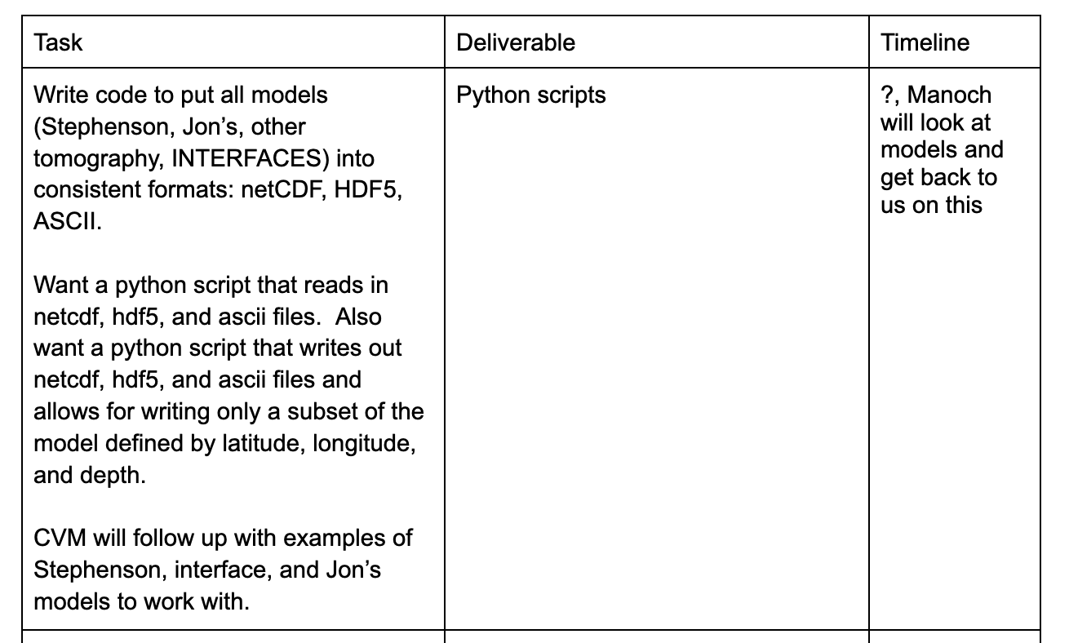
Status
From the meeting of 2023-12-22:
Downloaded Stephenson’s model
Received model from Jon (thank you!)
Manually converted Stephenson’s and Jon’s models to GeoCSV and netCDF
Evaluated the netCDF files
All files are available via Google Drive Folder
Code samples are available on GitHub

Slide 3
Formats
Proposed File Formats:
Format | Type | Description
GeoCSV | ASCII | An extension of the human readable, CSV (Comma-Separated Values) format with extensive metadata (more)
netCDF | Network Common Data Form (netCDF) , Version 4 Classic | Provides the netCDF-4 performance benefits while using the classic data model. Supports compression to reduce the file size (more)
Zarr or HDF5 | TBD
Metadata
All files (regardless of format) will include uniform extensive metadata that follow the CF Metadata Conventions.
Coordinate Systems
The proposed GeoCSV and netCDF file formats support both projected coordinate variables (x and y) and the geographic latitude and longitude variables. This would facilitate model query and visualization based on (x,y) or (longitude, latitude) coordinates.

Slide 4
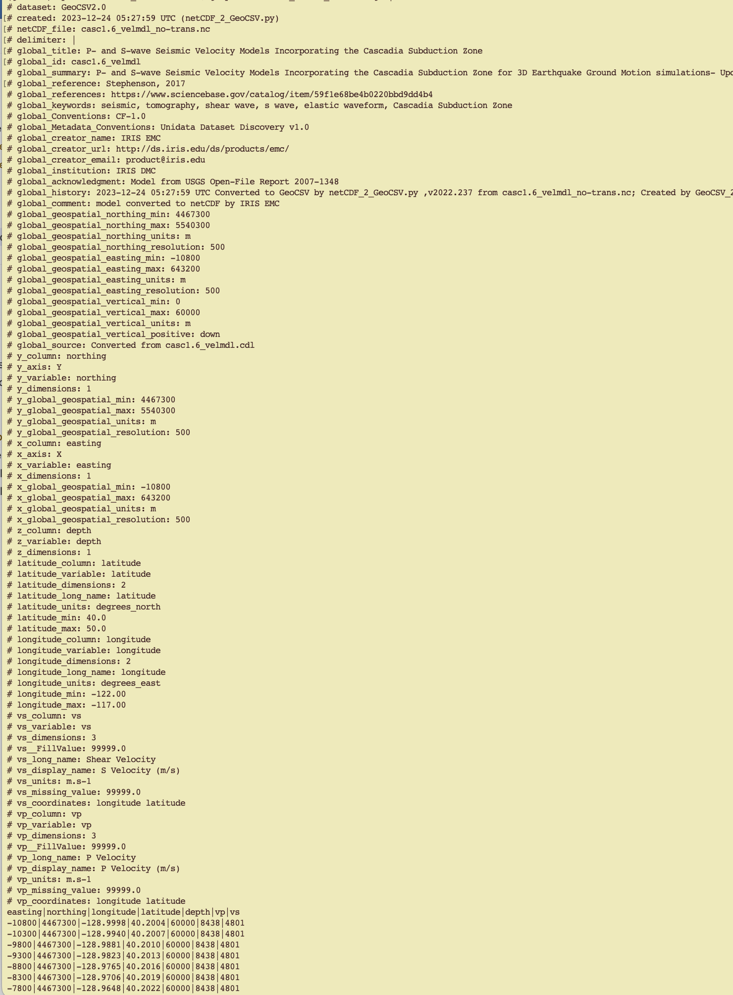
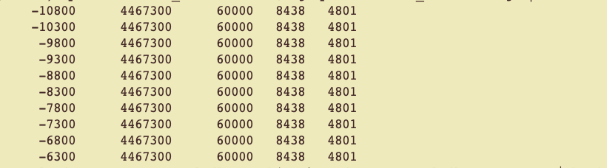
GeoCSV Header
Stephenson’s model

Slide 5
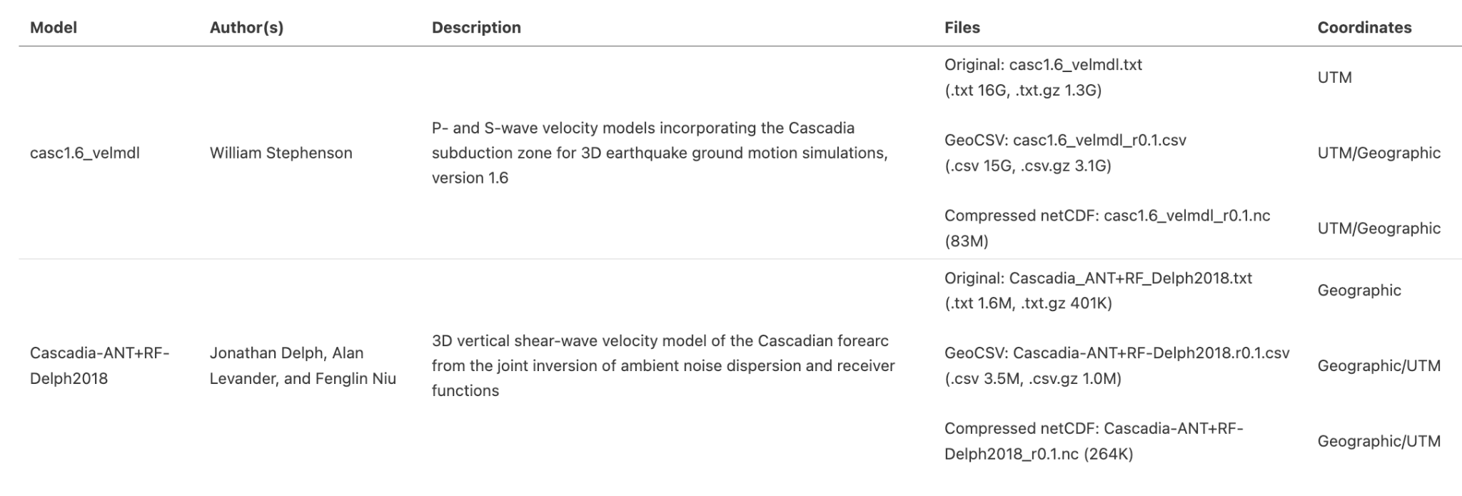
Converted Files
All files are available under the Google Drive Folder

Slide 6
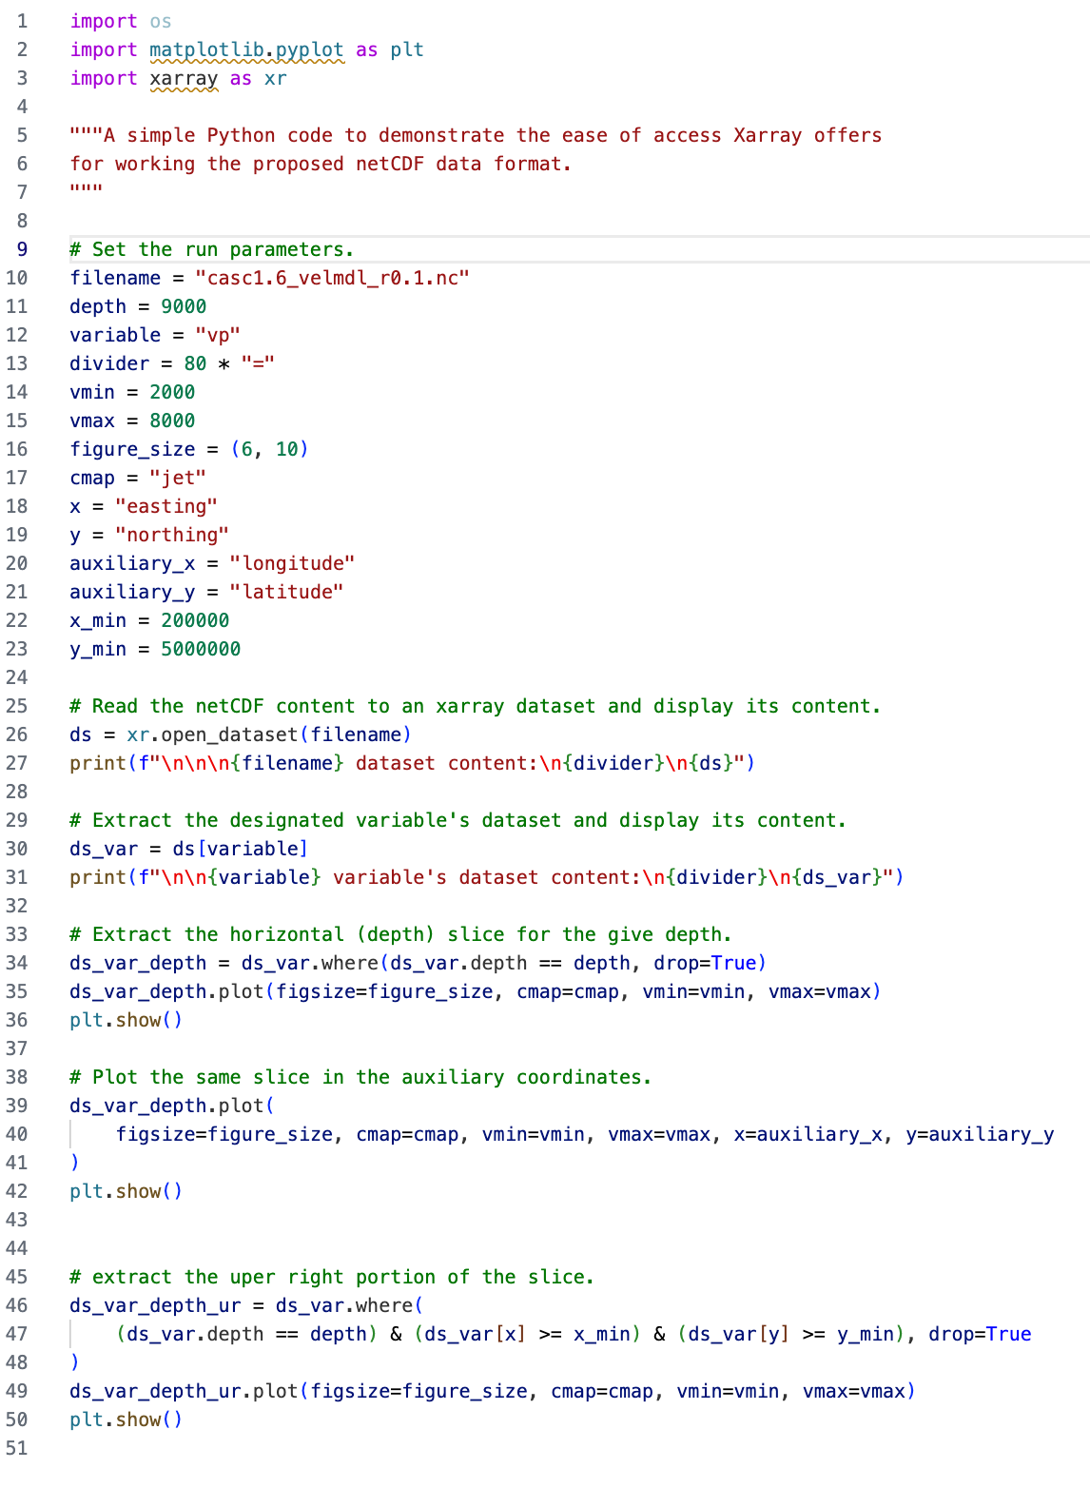
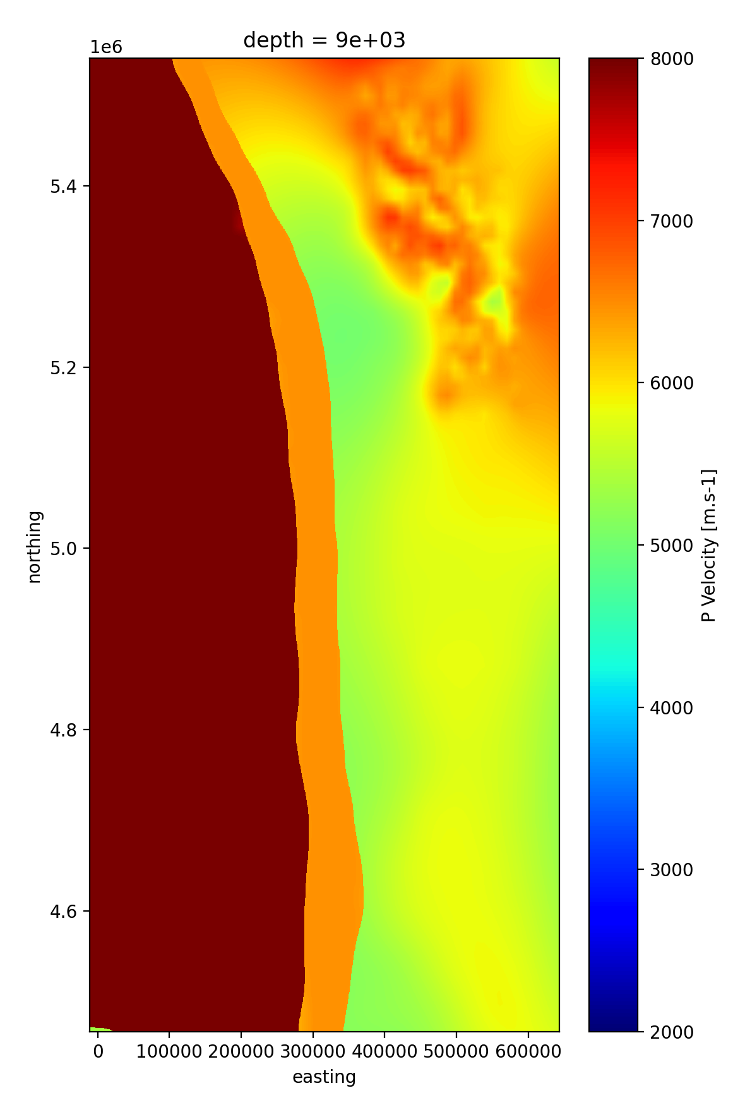
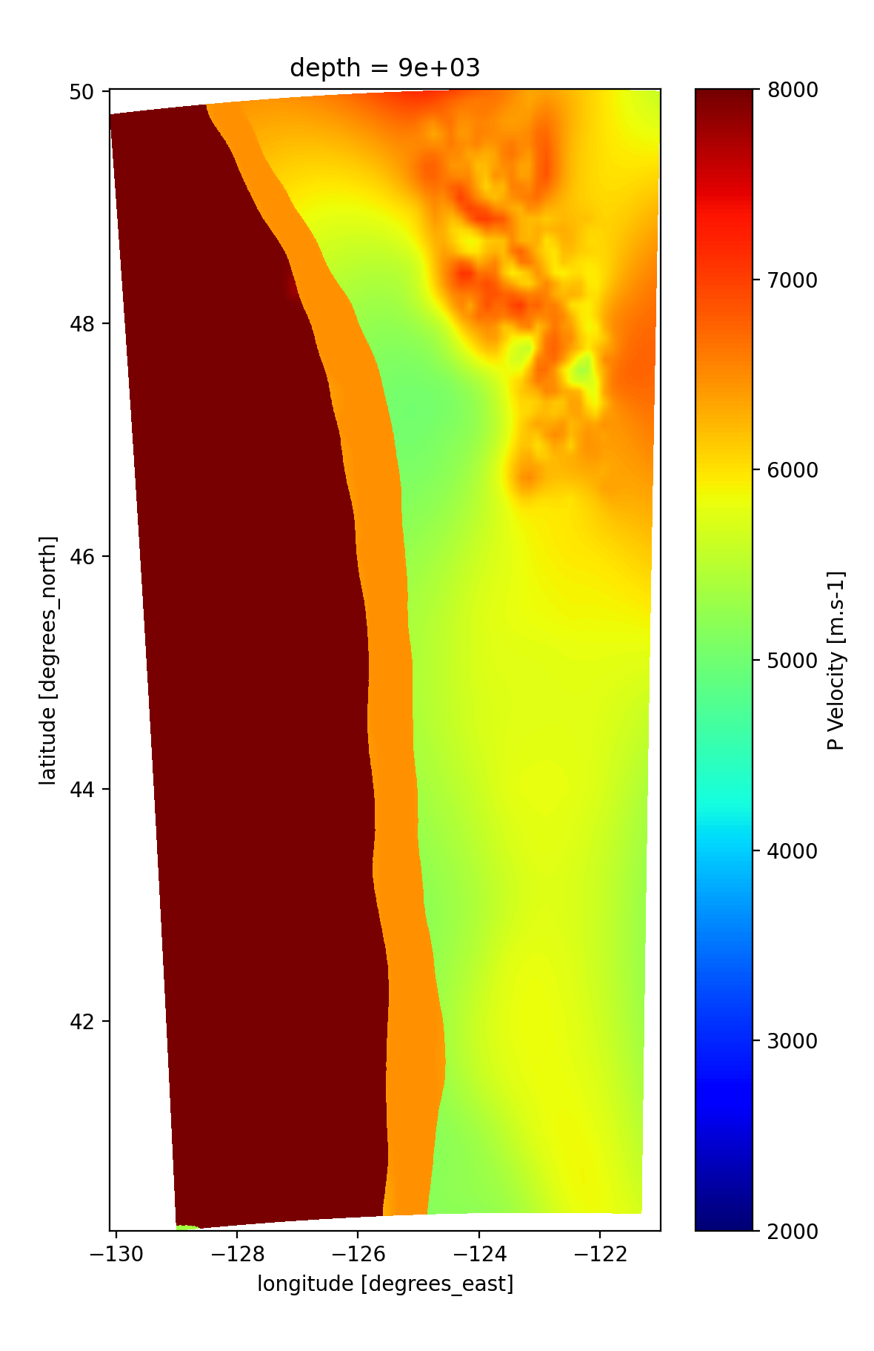
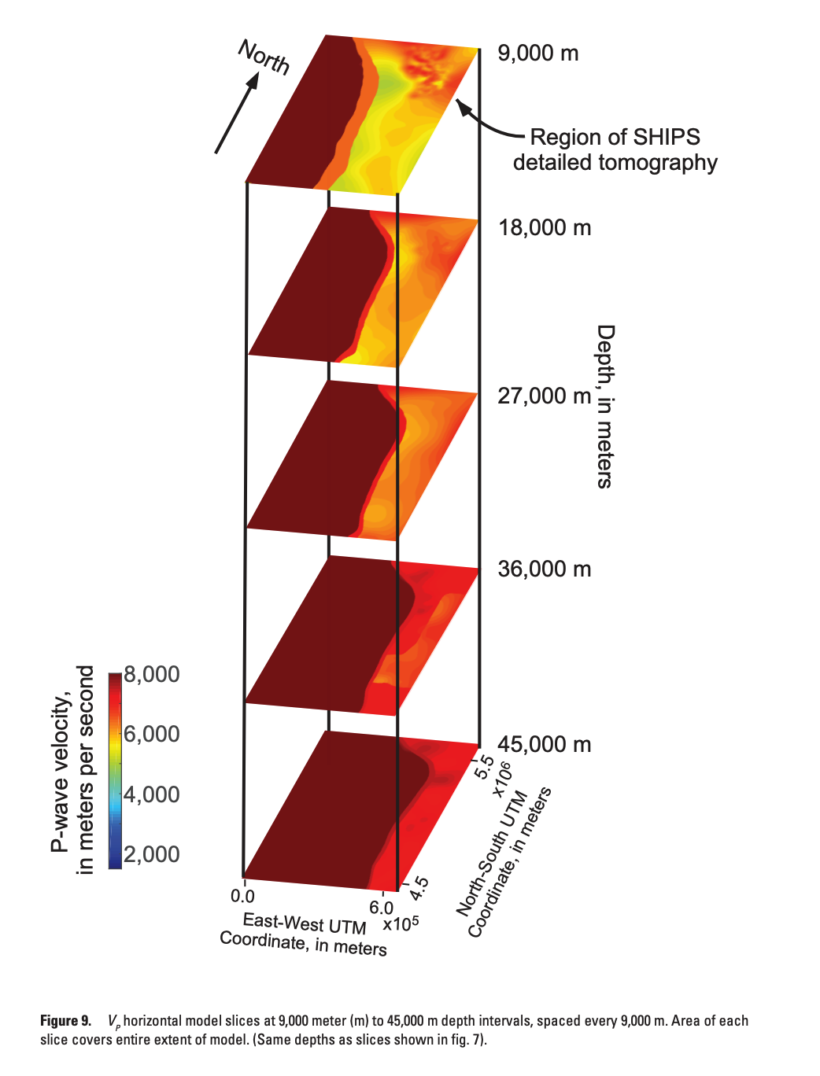
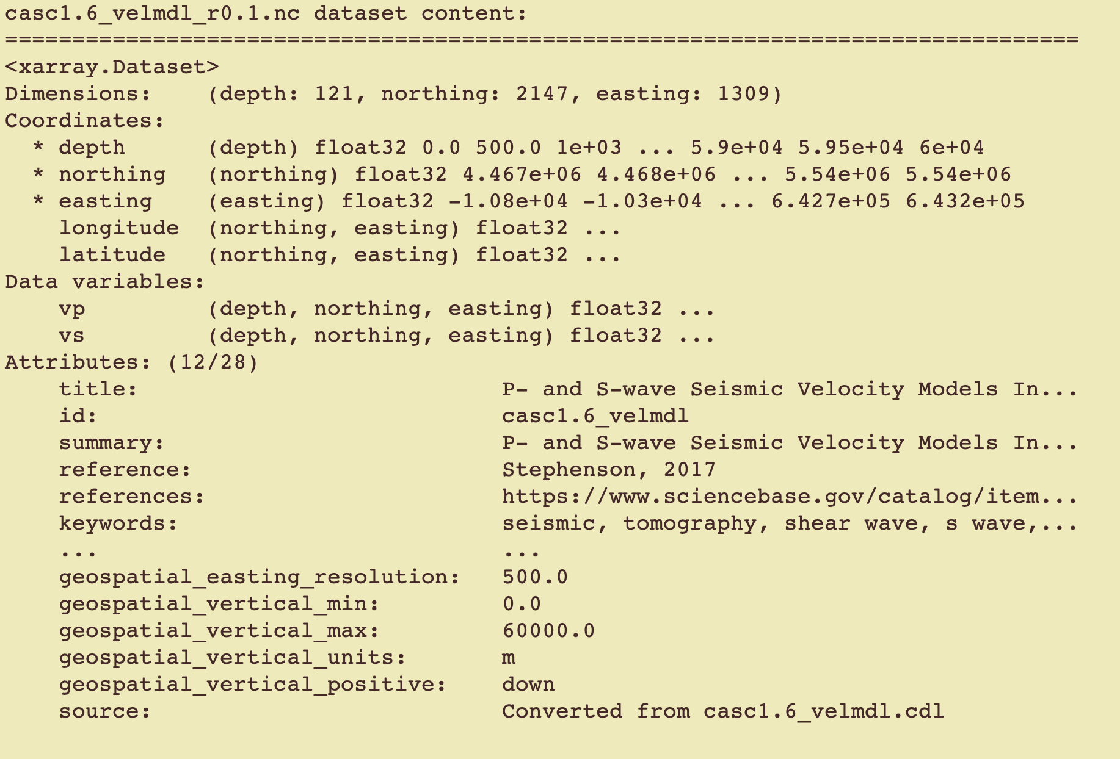
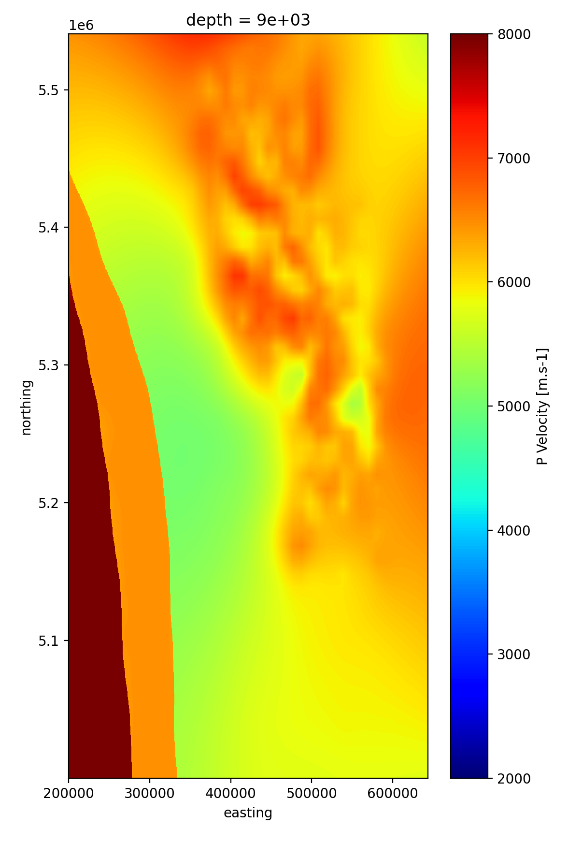
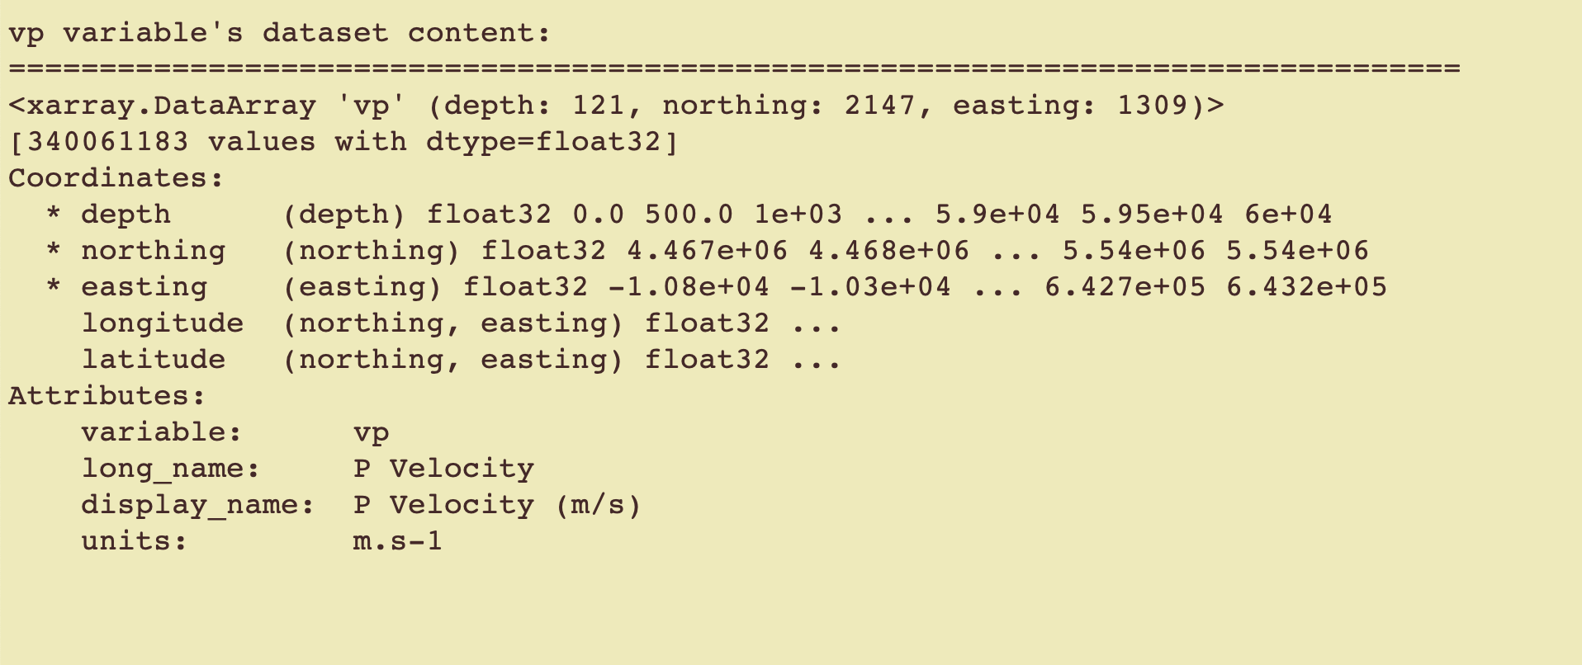

Exploring the netCDF Files Using Xarray (plotter.py)
Stephenson’s model

Slide 7
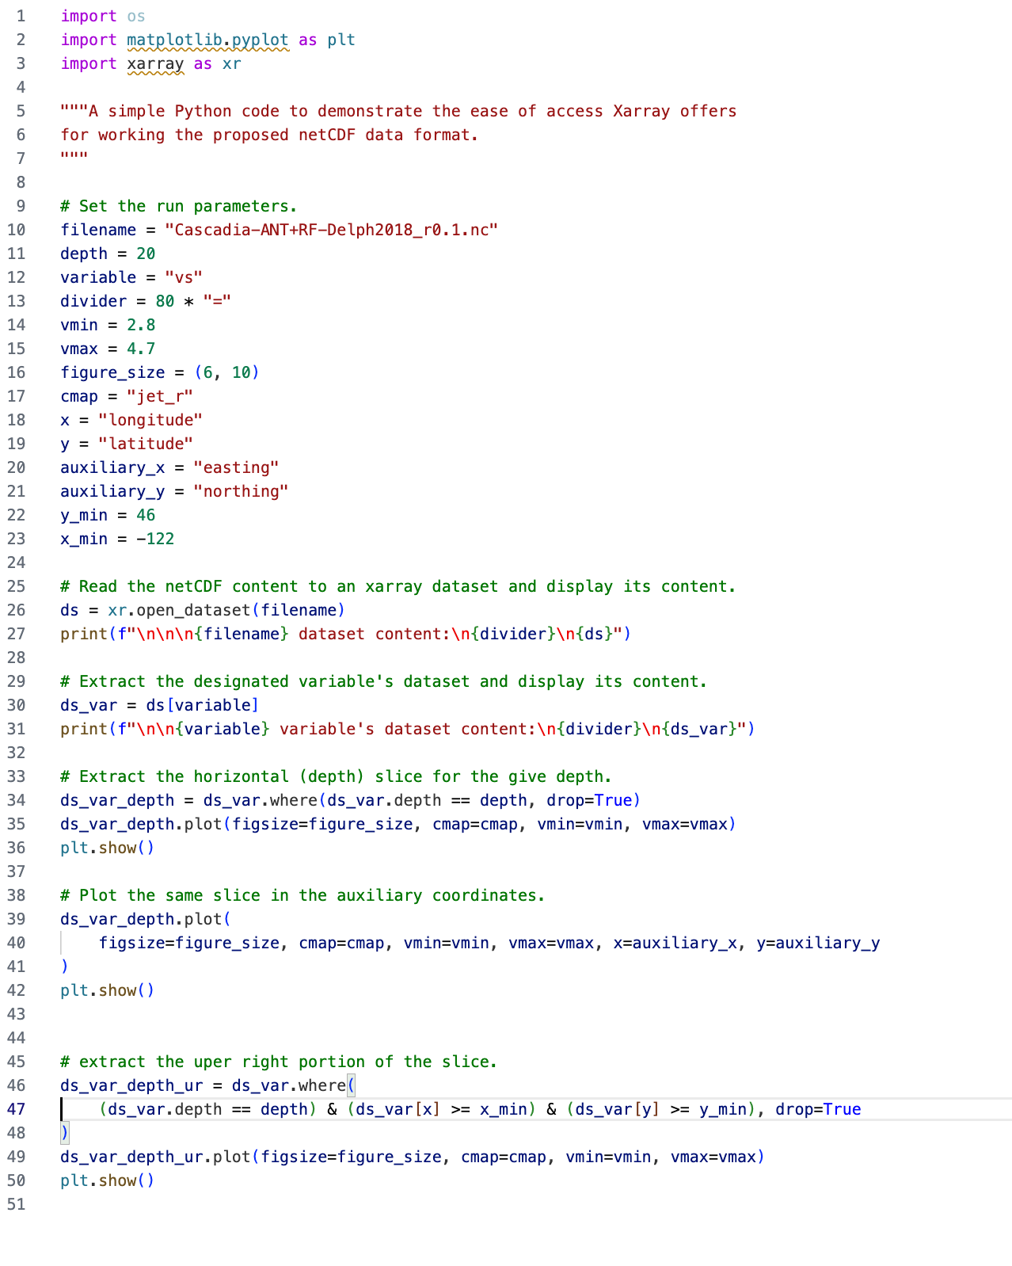
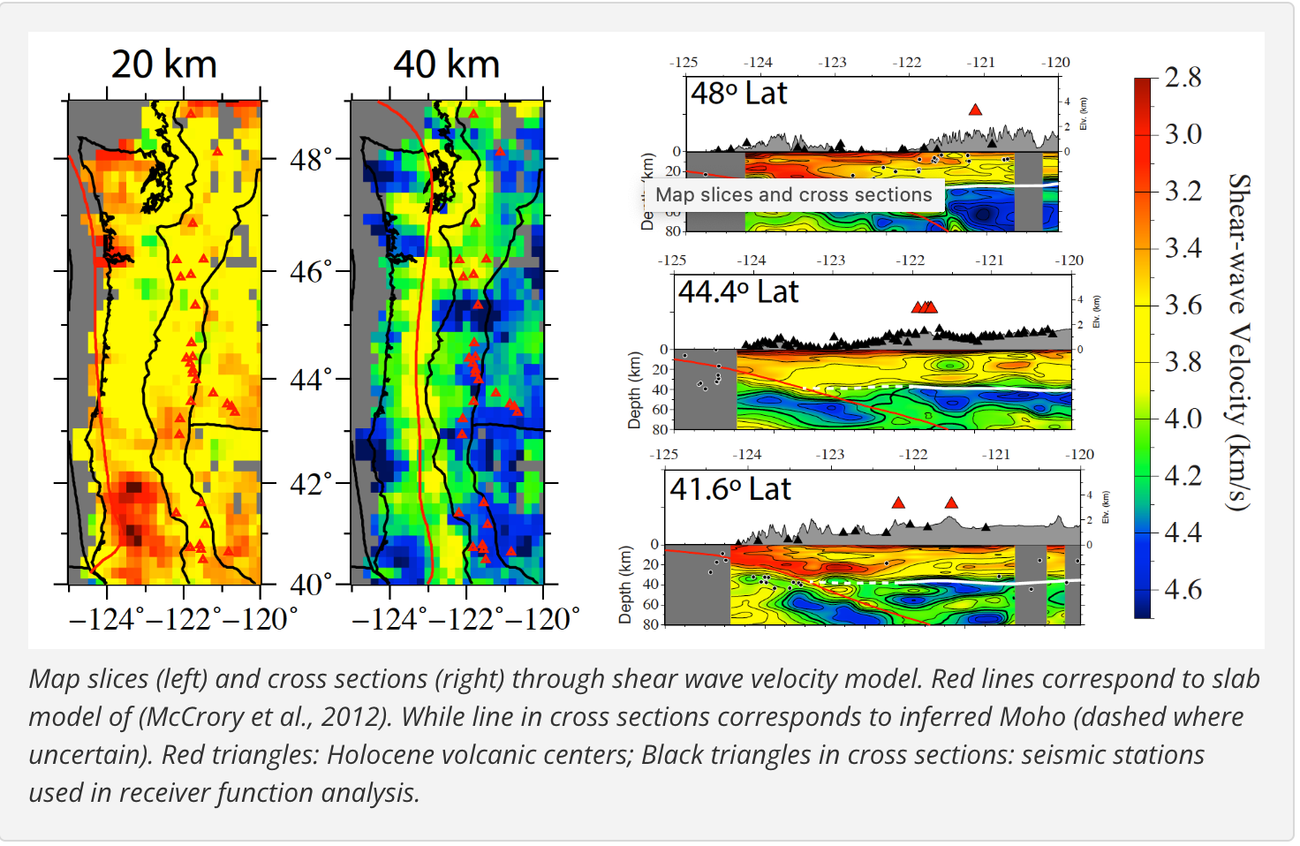
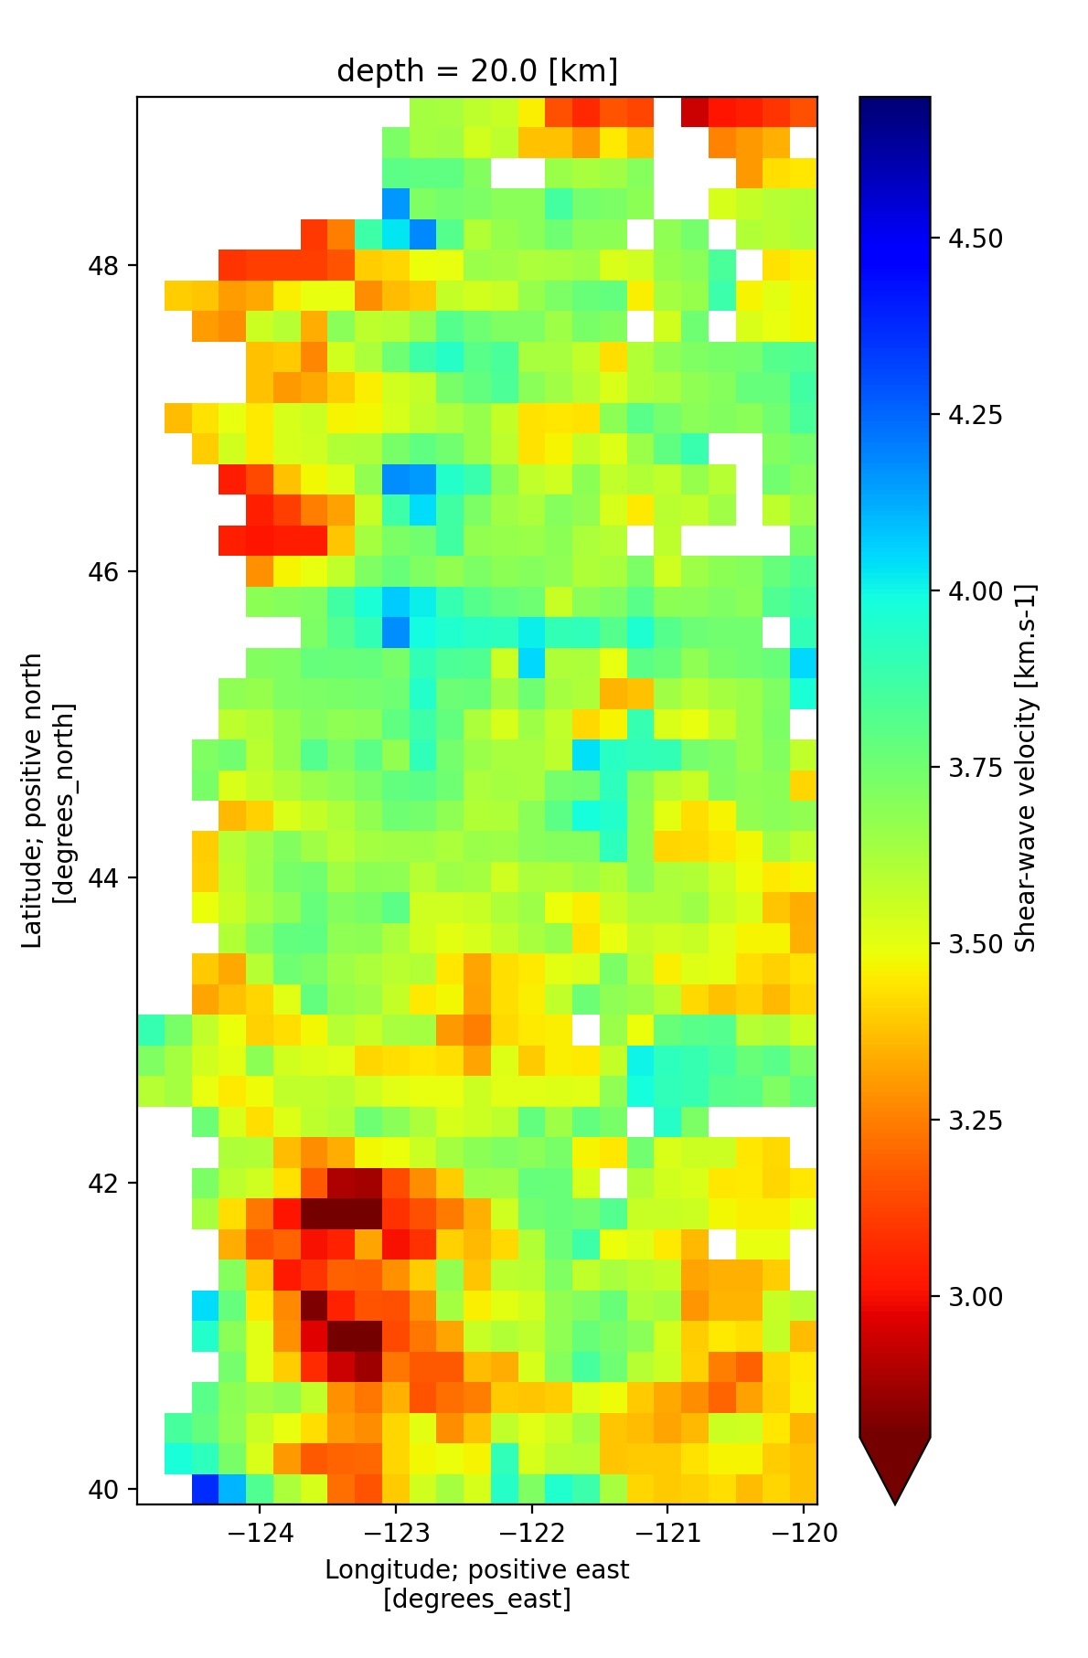
Exploring the netCDF Files Using Xarray (plotter.py)
Jon’s model

Slide 8
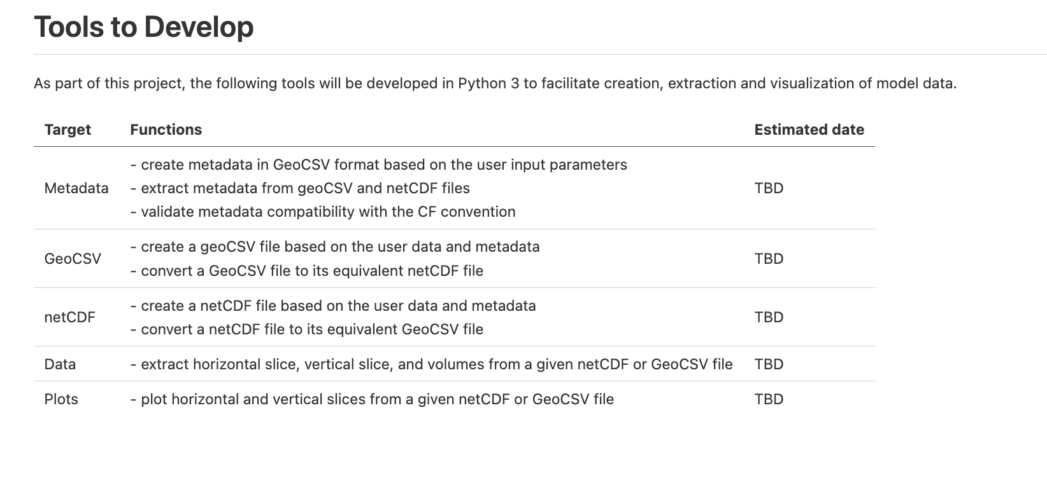
Tools to Develop

Slide 9
Questions?
Your feedback is highly appreciated. For questions, comments and suggestions please contact Manoch:
manochehr.bahavar@earthscope.org

